Slide 1

Rock-Paper-Scissor Game
CSE 231

Slide 2
Name | ID
Md. Nasim Ahmed | 2232936042
Sajid Hasan | 2222684042
Saif Hasan Saikot | 2221751642
S. M. Sultan Mahmud | 2112166642
Sabid Ibna Siddiq | 2132385642
Group-07

Slide 3
Rock-Paper-Scissor Game :
In this DLD project we are designing a real life game named “ Rock-Paper-Scissor” with some wires, breadboard, integrated circuit(ic), led , etc. This game can be played by two people. This design can be implemented using AND, OR, and other universal gates like NAND or NOR.
Result :
Four kind of results are shown in the project.
Player1 wins,
Player2 wins,
Draw( if same switches are on),
Invalid( if any player turns on more than one switch)

Slide 4
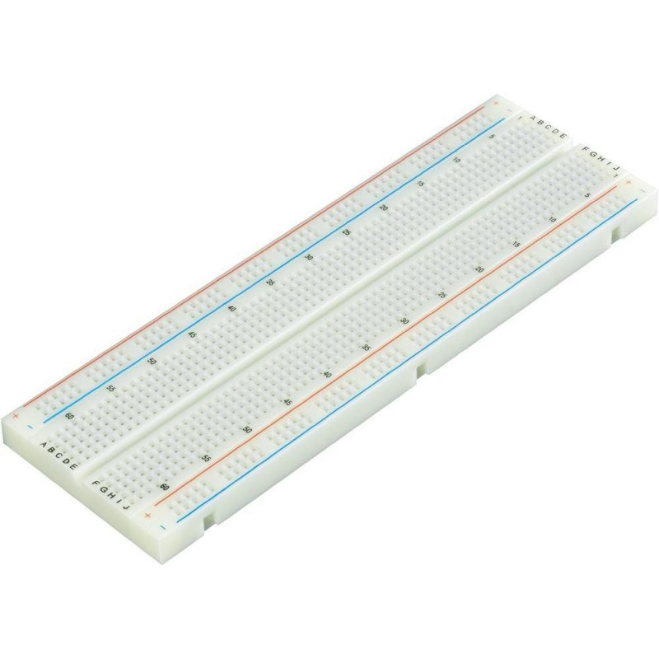


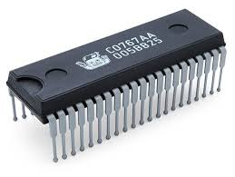
Apparatus :
IC 7408(AND 2-input)
IC 4073(AND 3-input)
IC 7432(OR 2-input)
IC 4075(OR 3-input)
IC 7404(NOT)
Battery 9v
LED
Converter
Connecting wires
Breadboard

Slide 5
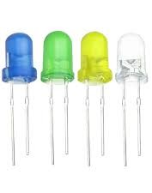
How to Play:
This game is made for 2 players . There are 3 input options for each player( Rock , Paper & Scissor ). Both of the players need to give an input by putting the wire in the Vcc chamber at the same time according to their choice and the result will be shown through LED.
Output LED’s:
1. 1st player wins - Green
2. 2nd player wins - Blue
3. Draw - Yellow
4. Invalid - White

Slide 6
Truth table if the result is a “Draw”
R₁ | P₁ | S₁ | R₂ | P₂ | S₂ | Result | R₁ | P₁ | S₁ | R₂ | P₂ | S₂ | Result
0 | 0 | 0 | 0 | 0 | 0 | 0 | 1 | 0 | 0 | 0 | 0 | 0 | 0
0 | 0 | 0 | 0 | 0 | 1 | 0 | 1 | 0 | 0 | 0 | 0 | 1 | 0
0 | 0 | 0 | 0 | 1 | 0 | 0 | 1 | 0 | 0 | 0 | 1 | 0 | 0
0 | 0 | 0 | 0 | 1 | 1 | 0 | 1 | 0 | 0 | 0 | 1 | 1 | 0
0 | 0 | 0 | 1 | 0 | 0 | 0 | 1 | 0 | 0 | 1 | 0 | 0 | 1
0 | 0 | 0 | 1 | 0 | 1 | 0 | 1 | 0 | 0 | 1 | 0 | 1 | 0
0 | 0 | 0 | 1 | 1 | 0 | 0 | 1 | 0 | 0 | 1 | 1 | 0 | 0
0 | 0 | 0 | 1 | 1 | 1 | 0 | 1 | 0 | 0 | 1 | 1 | 1 | 0
0 | 0 | 1 | 0 | 0 | 0 | 0 | 1 | 0 | 1 | 0 | 0 | 0 | 0
0 | 0 | 1 | 0 | 0 | 1 | 1 | 1 | 0 | 1 | 0 | 0 | 1 | 0
0 | 0 | 1 | 0 | 1 | 0 | 0 | 1 | 0 | 1 | 0 | 1 | 0 | 0
0 | 0 | 1 | 0 | 1 | 1 | 0 | 1 | 0 | 1 | 0 | 1 | 1 | 0
0 | 0 | 1 | 1 | 0 | 0 | 0 | 1 | 0 | 1 | 1 | 0 | 0 | 0
0 | 0 | 1 | 1 | 0 | 1 | 0 | 1 | 0 | 1 | 1 | 0 | 1 | 0
0 | 0 | 1 | 1 | 1 | 0 | 0 | 1 | 0 | 1 | 1 | 1 | 0 | 0
0 | 0 | 1 | 1 | 1 | 1 | 0 | 1 | 0 | 1 | 1 | 1 | 1 | 0
0 | 1 | 0 | 0 | 0 | 0 | 0 | 1 | 1 | 0 | 0 | 0 | 0 | 0
0 | 1 | 0 | 0 | 0 | 1 | 0 | 1 | 1 | 0 | 0 | 0 | 1 | 0
0 | 1 | 0 | 0 | 1 | 0 | 1 | 1 | 1 | 0 | 0 | 1 | 0 | 0
0 | 1 | 0 | 0 | 1 | 1 | 0 | 1 | 1 | 0 | 0 | 1 | 1 | 0
0 | 1 | 0 | 1 | 0 | 0 | 0 | 1 | 1 | 0 | 1 | 0 | 0 | 0
0 | 1 | 0 | 1 | 0 | 1 | 0 | 1 | 1 | 0 | 1 | 0 | 1 | 0
0 | 1 | 0 | 1 | 1 | 0 | 0 | 1 | 1 | 0 | 1 | 1 | 0 | 0
0 | 1 | 0 | 1 | 1 | 1 | 0 | 1 | 1 | 0 | 1 | 1 | 1 | 0
0 | 1 | 1 | 0 | 0 | 0 | 0 | 1 | 1 | 1 | 0 | 0 | 0 | 0
0 | 1 | 1 | 0 | 0 | 1 | 0 | 1 | 1 | 1 | 0 | 0 | 1 | 0
0 | 1 | 1 | 0 | 1 | 0 | 0 | 1 | 1 | 1 | 0 | 1 | 0 | 0
0 | 1 | 1 | 0 | 1 | 1 | 0 | 1 | 1 | 1 | 0 | 1 | 1 | 0
0 | 1 | 1 | 1 | 0 | 0 | 0 | 1 | 1 | 1 | 1 | 0 | 0 | 0
0 | 1 | 1 | 1 | 0 | 1 | 0 | 1 | 1 | 1 | 1 | 0 | 1 | 0
0 | 1 | 1 | 1 | 1 | 0 | 0 | 1 | 1 | 1 | 1 | 1 | 0 | 0
0 | 1 | 1 | 1 | 1 | 1 | 0 | 1 | 1 | 1 | 1 | 1 | 1 | 0

Slide 7
K-map if the result is a “Draw”
R₁P₁S₁\R₂P₂S₂ | 000 | 001 | 011 | 010 | 110 | 111 | 101 | 100
000 | 0 | 0 | 0 | 0 | 0 | 0 | 0 | 0
001 | 0 | 1 | 0 | 0 | 0 | 0 | 0 | 0
011 | 0 | 0 | 0 | 0 | 0 | 0 | 0 | 0
010 | 0 | 0 | 0 | 1 | 0 | 0 | 0 | 0
110 | 0 | 0 | 0 | 0 | 0 | 0 | 0 | 0
111 | 0 | 0 | 0 | 0 | 0 | 0 | 0 | 0
101 | 0 | 0 | 0 | 0 | 0 | 0 | 0 | 0
100 | 0 | 0 | 0 | 0 | 0 | 0 | 0 | 1
Draw : R₁P₁’S₁’R₂P₂’S₂’+ R₁‘P₁S₁’R₂‘P₂S₂’+ R₁‘P₁’S₁R₂‘P₂’S₂

Slide 8
Truth table if 1st player gets a point.
R₁ | P₁ | S₁ | R₂ | P₂ | S₂ | Result | R₁ | P₁ | S₁ | R₂ | P₂ | S₂ | Result
0 | 0 | 0 | 0 | 0 | 0 | 0 | 1 | 0 | 0 | 0 | 0 | 0 | 0
0 | 0 | 0 | 0 | 0 | 1 | 0 | 1 | 0 | 0 | 0 | 0 | 1 | 1
0 | 0 | 0 | 0 | 1 | 0 | 0 | 1 | 0 | 0 | 0 | 1 | 0 | 0
0 | 0 | 0 | 0 | 1 | 1 | 0 | 1 | 0 | 0 | 0 | 1 | 1 | 0
0 | 0 | 0 | 1 | 0 | 0 | 0 | 1 | 0 | 0 | 1 | 0 | 0 | 0
0 | 0 | 0 | 1 | 0 | 1 | 0 | 1 | 0 | 0 | 1 | 0 | 1 | 0
0 | 0 | 0 | 1 | 1 | 0 | 0 | 1 | 0 | 0 | 1 | 1 | 0 | 0
0 | 0 | 0 | 1 | 1 | 1 | 0 | 1 | 0 | 0 | 1 | 1 | 1 | 0
0 | 0 | 1 | 0 | 0 | 0 | 0 | 1 | 0 | 1 | 0 | 0 | 0 | 0
0 | 0 | 1 | 0 | 0 | 1 | 0 | 1 | 0 | 1 | 0 | 0 | 1 | 0
0 | 0 | 1 | 0 | 1 | 0 | 1 | 1 | 0 | 1 | 0 | 1 | 0 | 0
0 | 0 | 1 | 0 | 1 | 1 | 0 | 1 | 0 | 1 | 0 | 1 | 1 | 0
0 | 0 | 1 | 1 | 0 | 0 | 0 | 1 | 0 | 1 | 1 | 0 | 0 | 0
0 | 0 | 1 | 1 | 0 | 1 | 0 | 1 | 0 | 1 | 1 | 0 | 1 | 0
0 | 0 | 1 | 1 | 1 | 0 | 0 | 1 | 0 | 1 | 1 | 1 | 0 | 0
0 | 0 | 1 | 1 | 1 | 1 | 0 | 1 | 0 | 1 | 1 | 1 | 1 | 0
0 | 1 | 0 | 0 | 0 | 0 | 0 | 1 | 1 | 0 | 0 | 0 | 0 | 0
0 | 1 | 0 | 0 | 0 | 1 | 0 | 1 | 1 | 0 | 0 | 0 | 1 | 0
0 | 1 | 0 | 0 | 1 | 0 | 0 | 1 | 1 | 0 | 0 | 1 | 0 | 0
0 | 1 | 0 | 0 | 1 | 1 | 0 | 1 | 1 | 0 | 0 | 1 | 1 | 0
0 | 1 | 0 | 1 | 0 | 0 | 1 | 1 | 1 | 0 | 1 | 0 | 0 | 0
0 | 1 | 0 | 1 | 0 | 1 | 0 | 1 | 1 | 0 | 1 | 0 | 1 | 0
0 | 1 | 0 | 1 | 1 | 0 | 0 | 1 | 1 | 0 | 1 | 1 | 0 | 0
0 | 1 | 0 | 1 | 1 | 1 | 0 | 1 | 1 | 0 | 1 | 1 | 1 | 0
0 | 1 | 1 | 0 | 0 | 0 | 0 | 1 | 1 | 1 | 0 | 0 | 0 | 0
0 | 1 | 1 | 0 | 0 | 1 | 0 | 1 | 1 | 1 | 0 | 0 | 1 | 0
0 | 1 | 1 | 0 | 1 | 0 | 0 | 1 | 1 | 1 | 0 | 1 | 0 | 0
0 | 1 | 1 | 0 | 1 | 1 | 0 | 1 | 1 | 1 | 0 | 1 | 1 | 0
0 | 1 | 1 | 1 | 0 | 0 | 0 | 1 | 1 | 1 | 1 | 0 | 0 | 0
0 | 1 | 1 | 1 | 0 | 1 | 0 | 1 | 1 | 1 | 1 | 0 | 1 | 0
0 | 1 | 1 | 1 | 1 | 0 | 0 | 1 | 1 | 1 | 1 | 1 | 0 | 0
0 | 1 | 1 | 1 | 1 | 1 | 0 | 1 | 1 | 1 | 1 | 1 | 1 | 0

Slide 9
K-map if 1st player gets a point.
R₁P₁S₁\R₂P₂S₂ | 000 | 001 | 011 | 010 | 110 | 111 | 101 | 100
000 | 0 | 0 | 0 | 0 | 0 | 0 | 0 | 0
001 | 0 | 0 | 0 | 1 | 0 | 0 | 0 | 0
011 | 0 | 0 | 0 | 0 | 0 | 0 | 0 | 0
010 | 0 | 0 | 0 | 0 | 0 | 0 | 0 | 1
110 | 0 | 0 | 0 | 0 | 0 | 0 | 0 | 0
111 | 0 | 0 | 0 | 0 | 0 | 0 | 0 | 0
101 | 0 | 0 | 0 | 0 | 0 | 0 | 0 | 0
100 | 0 | 1 | 0 | 0 | 0 | 0 | 0 | 0
1st player : R₁P₁’S₁’R₂‘P₂’S₂+ R₁‘P₁S₁’R₂P₂‘S₂’+ R₁‘P₁’S₁R₂‘P₂S₂‘

Slide 10
Truth table if 2nd player gets a point.
R₁ | P₁ | S₁ | R₂ | P₂ | S₂ | Result | R₁ | P₁ | S₁ | R₂ | P₂ | S₂ | Result
0 | 0 | 0 | 0 | 0 | 0 | 0 | 1 | 0 | 0 | 0 | 0 | 0 | 0
0 | 0 | 0 | 0 | 0 | 1 | 0 | 1 | 0 | 0 | 0 | 0 | 1 | 0
0 | 0 | 0 | 0 | 1 | 0 | 0 | 1 | 0 | 0 | 0 | 1 | 0 | 1
0 | 0 | 0 | 0 | 1 | 1 | 0 | 1 | 0 | 0 | 0 | 1 | 1 | 0
0 | 0 | 0 | 1 | 0 | 0 | 0 | 1 | 0 | 0 | 1 | 0 | 0 | 0
0 | 0 | 0 | 1 | 0 | 1 | 0 | 1 | 0 | 0 | 1 | 0 | 1 | 0
0 | 0 | 0 | 1 | 1 | 0 | 0 | 1 | 0 | 0 | 1 | 1 | 0 | 0
0 | 0 | 0 | 1 | 1 | 1 | 0 | 1 | 0 | 0 | 1 | 1 | 1 | 0
0 | 0 | 1 | 0 | 0 | 0 | 0 | 1 | 0 | 1 | 0 | 0 | 0 | 0
0 | 0 | 1 | 0 | 0 | 1 | 0 | 1 | 0 | 1 | 0 | 0 | 1 | 0
0 | 0 | 1 | 0 | 1 | 0 | 0 | 1 | 0 | 1 | 0 | 1 | 0 | 0
0 | 0 | 1 | 0 | 1 | 1 | 0 | 1 | 0 | 1 | 0 | 1 | 1 | 0
0 | 0 | 1 | 1 | 0 | 0 | 1 | 1 | 0 | 1 | 1 | 0 | 0 | 0
0 | 0 | 1 | 1 | 0 | 1 | 0 | 1 | 0 | 1 | 1 | 0 | 1 | 0
0 | 0 | 1 | 1 | 1 | 0 | 0 | 1 | 0 | 1 | 1 | 1 | 0 | 0
0 | 0 | 1 | 1 | 1 | 1 | 0 | 1 | 0 | 1 | 1 | 1 | 1 | 0
0 | 1 | 0 | 0 | 0 | 0 | 0 | 1 | 1 | 0 | 0 | 0 | 0 | 0
0 | 1 | 0 | 0 | 0 | 1 | 1 | 1 | 1 | 0 | 0 | 0 | 1 | 0
0 | 1 | 0 | 0 | 1 | 0 | 0 | 1 | 1 | 0 | 0 | 1 | 0 | 0
0 | 1 | 0 | 0 | 1 | 1 | 0 | 1 | 1 | 0 | 0 | 1 | 1 | 0
0 | 1 | 0 | 1 | 0 | 0 | 0 | 1 | 1 | 0 | 1 | 0 | 0 | 0
0 | 1 | 0 | 1 | 0 | 1 | 0 | 1 | 1 | 0 | 1 | 0 | 1 | 0
0 | 1 | 0 | 1 | 1 | 0 | 0 | 1 | 1 | 0 | 1 | 1 | 0 | 0
0 | 1 | 0 | 1 | 1 | 1 | 0 | 1 | 1 | 0 | 1 | 1 | 1 | 0
0 | 1 | 1 | 0 | 0 | 0 | 0 | 1 | 1 | 1 | 0 | 0 | 0 | 0
0 | 1 | 1 | 0 | 0 | 1 | 0 | 1 | 1 | 1 | 0 | 0 | 1 | 0
0 | 1 | 1 | 0 | 1 | 0 | 0 | 1 | 1 | 1 | 0 | 1 | 0 | 0
0 | 1 | 1 | 0 | 1 | 1 | 0 | 1 | 1 | 1 | 0 | 1 | 1 | 0
0 | 1 | 1 | 1 | 0 | 0 | 0 | 1 | 1 | 1 | 1 | 0 | 0 | 0
0 | 1 | 1 | 1 | 0 | 1 | 0 | 1 | 1 | 1 | 1 | 0 | 1 | 0
0 | 1 | 1 | 1 | 1 | 0 | 0 | 1 | 1 | 1 | 1 | 1 | 0 | 0
0 | 1 | 1 | 1 | 1 | 1 | 0 | 1 | 1 | 1 | 1 | 1 | 1 | 0

Slide 11
K-map if 2nd player gets a point.
R₁P₁S₁\R₂P₂S₂ | 000 | 001 | 011 | 010 | 110 | 111 | 101 | 100
000 | 0 | 0 | 0 | 0 | 0 | 0 | 0 | 0
001 | 0 | 0 | 0 | 0 | 0 | 0 | 0 | 1
011 | 0 | 0 | 0 | 0 | 0 | 0 | 0 | 0
010 | 0 | 1 | 0 | 0 | 0 | 0 | 0 | 0
110 | 0 | 0 | 0 | 0 | 0 | 0 | 0 | 0
111 | 0 | 0 | 0 | 0 | 0 | 0 | 0 | 0
101 | 0 | 0 | 0 | 0 | 0 | 0 | 0 | 0
100 | 0 | 0 | 0 | 1 | 0 | 0 | 0 | 0
2nd player : R₁P₁’S₁’R₂‘P₂S₂‘+ R₁‘P₁S₁’R₂‘P₂‘S₂+ R₁‘P₁’S₁R₂P₂‘S₂‘

Slide 12
Truth table if inputs are invalid.
R₁ | P₁ | S₁ | R₂ | P₂ | S₂ | Result | R₁ | P₁ | S₁ | R₂ | P₂ | S₂ | Result
0 | 0 | 0 | 0 | 0 | 0 | 1 | 1 | 0 | 0 | 0 | 0 | 0 | 1
0 | 0 | 0 | 0 | 0 | 1 | 1 | 1 | 0 | 0 | 0 | 0 | 1 | 0
0 | 0 | 0 | 0 | 1 | 0 | 1 | 1 | 0 | 0 | 0 | 1 | 0 | 0
0 | 0 | 0 | 0 | 1 | 1 | 1 | 1 | 0 | 0 | 0 | 1 | 1 | 1
0 | 0 | 0 | 1 | 0 | 0 | 1 | 1 | 0 | 0 | 1 | 0 | 0 | 0
0 | 0 | 0 | 1 | 0 | 1 | 1 | 1 | 0 | 0 | 1 | 0 | 1 | 1
0 | 0 | 0 | 1 | 1 | 0 | 1 | 1 | 0 | 0 | 1 | 1 | 0 | 1
0 | 0 | 0 | 1 | 1 | 1 | 1 | 1 | 0 | 0 | 1 | 1 | 1 | 1
0 | 0 | 1 | 0 | 0 | 0 | 1 | 1 | 0 | 1 | 0 | 0 | 0 | 1
0 | 0 | 1 | 0 | 0 | 1 | 0 | 1 | 0 | 1 | 0 | 0 | 1 | 1
0 | 0 | 1 | 0 | 1 | 0 | 0 | 1 | 0 | 1 | 0 | 1 | 0 | 1
0 | 0 | 1 | 0 | 1 | 1 | 1 | 1 | 0 | 1 | 0 | 1 | 1 | 1
0 | 0 | 1 | 1 | 0 | 0 | 0 | 1 | 0 | 1 | 1 | 0 | 0 | 1
0 | 0 | 1 | 1 | 0 | 1 | 1 | 1 | 0 | 1 | 1 | 0 | 1 | 1
0 | 0 | 1 | 1 | 1 | 0 | 1 | 1 | 0 | 1 | 1 | 1 | 0 | 1
0 | 0 | 1 | 1 | 1 | 1 | 1 | 1 | 0 | 1 | 1 | 1 | 1 | 1
0 | 1 | 0 | 0 | 0 | 0 | 1 | 1 | 1 | 0 | 0 | 0 | 0 | 1
0 | 1 | 0 | 0 | 0 | 1 | 0 | 1 | 1 | 0 | 0 | 0 | 1 | 1
0 | 1 | 0 | 0 | 1 | 0 | 0 | 1 | 1 | 0 | 0 | 1 | 0 | 1
0 | 1 | 0 | 0 | 1 | 1 | 1 | 1 | 1 | 0 | 0 | 1 | 1 | 1
0 | 1 | 0 | 1 | 0 | 0 | 0 | 1 | 1 | 0 | 1 | 0 | 0 | 1
0 | 1 | 0 | 1 | 0 | 1 | 1 | 1 | 1 | 0 | 1 | 0 | 1 | 1
0 | 1 | 0 | 1 | 1 | 0 | 1 | 1 | 1 | 0 | 1 | 1 | 0 | 1
0 | 1 | 0 | 1 | 1 | 1 | 1 | 1 | 1 | 0 | 1 | 1 | 1 | 1
0 | 1 | 1 | 0 | 0 | 0 | 1 | 1 | 1 | 1 | 0 | 0 | 0 | 1
0 | 1 | 1 | 0 | 0 | 1 | 1 | 1 | 1 | 1 | 0 | 0 | 1 | 1
0 | 1 | 1 | 0 | 1 | 0 | 1 | 1 | 1 | 1 | 0 | 1 | 0 | 1
0 | 1 | 1 | 0 | 1 | 1 | 1 | 1 | 1 | 1 | 0 | 1 | 1 | 1
0 | 1 | 1 | 1 | 0 | 0 | 1 | 1 | 1 | 1 | 1 | 0 | 0 | 1
0 | 1 | 1 | 1 | 0 | 1 | 1 | 1 | 1 | 1 | 1 | 0 | 1 | 1
0 | 1 | 1 | 1 | 1 | 0 | 1 | 1 | 1 | 1 | 1 | 1 | 0 | 1
0 | 1 | 1 | 1 | 1 | 1 | 1 | 1 | 1 | 1 | 1 | 1 | 1 | 1

Slide 13
K-map if inputs are invalid.
R₁P₁S₁\R₂P₂S₂ | 000 | 001 | 011 | 010 | 110 | 111 | 101 | 100
000 | 1 | 1 | 1 | 1 | 1 | 1 | 1 | 1
001 | 1 | 0 | 1 | 0 | 1 | 1 | 1 | 0
011 | 1 | 1 | 1 | 1 | 1 | 1 | 1 | 1
010 | 1 | 0 | 1 | 0 | 1 | 1 | 1 | 0
110 | 1 | 1 | 1 | 1 | 1 | 1 | 1 | 1
111 | 1 | 1 | 1 | 1 | 1 | 1 | 1 | 1
101 | 1 | 1 | 1 | 1 | 1 | 1 | 1 | 1
100 | 1 | 0 | 1 | 0 | 1 | 1 | 1 | 0
Invalid : R₂‘P₂’S₂’+ R₁P₁+ R₁S₁+ R₂P₂+ R₂S₂+ R₂‘P₂S₂+ R₁‘P₁’S₁’+ R₁‘P₁S₁

Slide 14
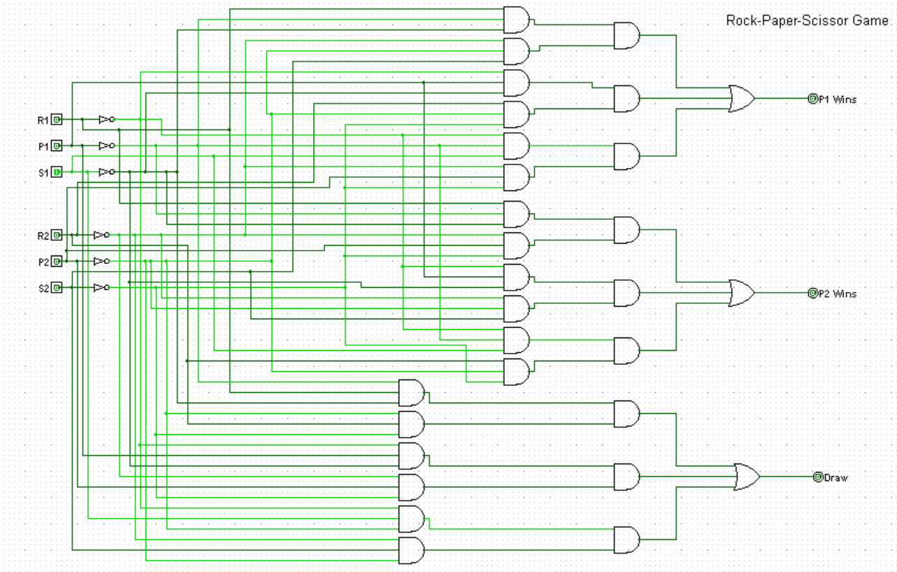
Simulation

Slide 15
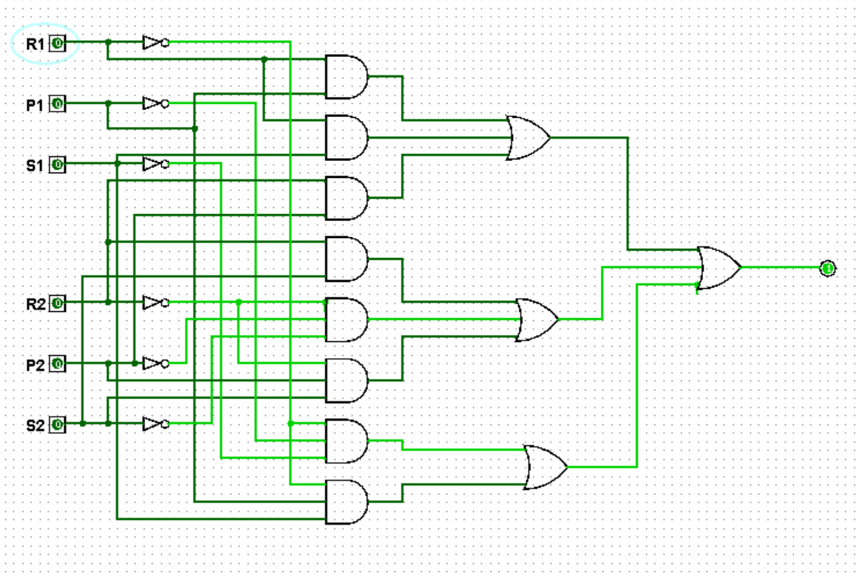
Simulation

Slide 16
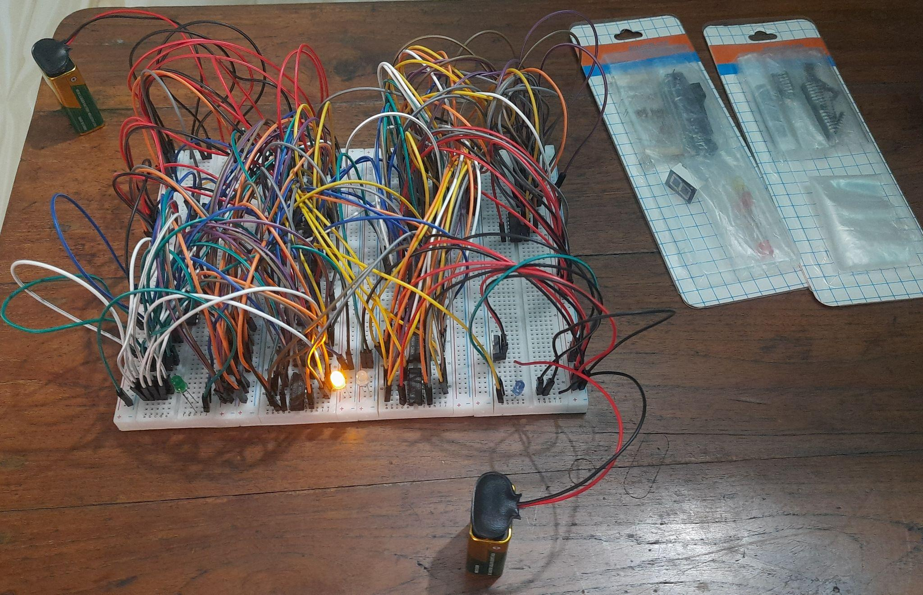

Slide 17


Slide 18


